Slide 1
Final Project Presentation
Yu Feng and Luke Allen

Slide 2
Problem Description
The problem that was assigned for the final project was to create an architecture design for the MSDAP code that was created in the midterm project. Said architecture design must be designed so that each functional block is stand alone and functional closure. Modifications to the code were needed so that it would conform to this architecture design. Once this is complete, we were tasked with synthesizing the code using Synopsis Design Compiler. In order to do so, the code had to be further altered so that it contained only code that is synthesizable. Finally, we were tasked with verifying the functionality of the synthesized design by simulating it in modelsim.

Slide 3
Input/Output Modes
Our assigned input and output modes are as follows:
Input data: Serial
Output data: parallel
start: Active high
frame: active high
reset_n: active low.

Slide 4
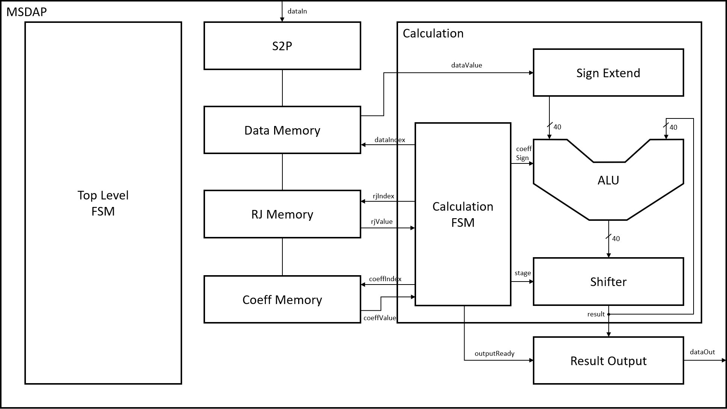
Architecture Design

Slide 5
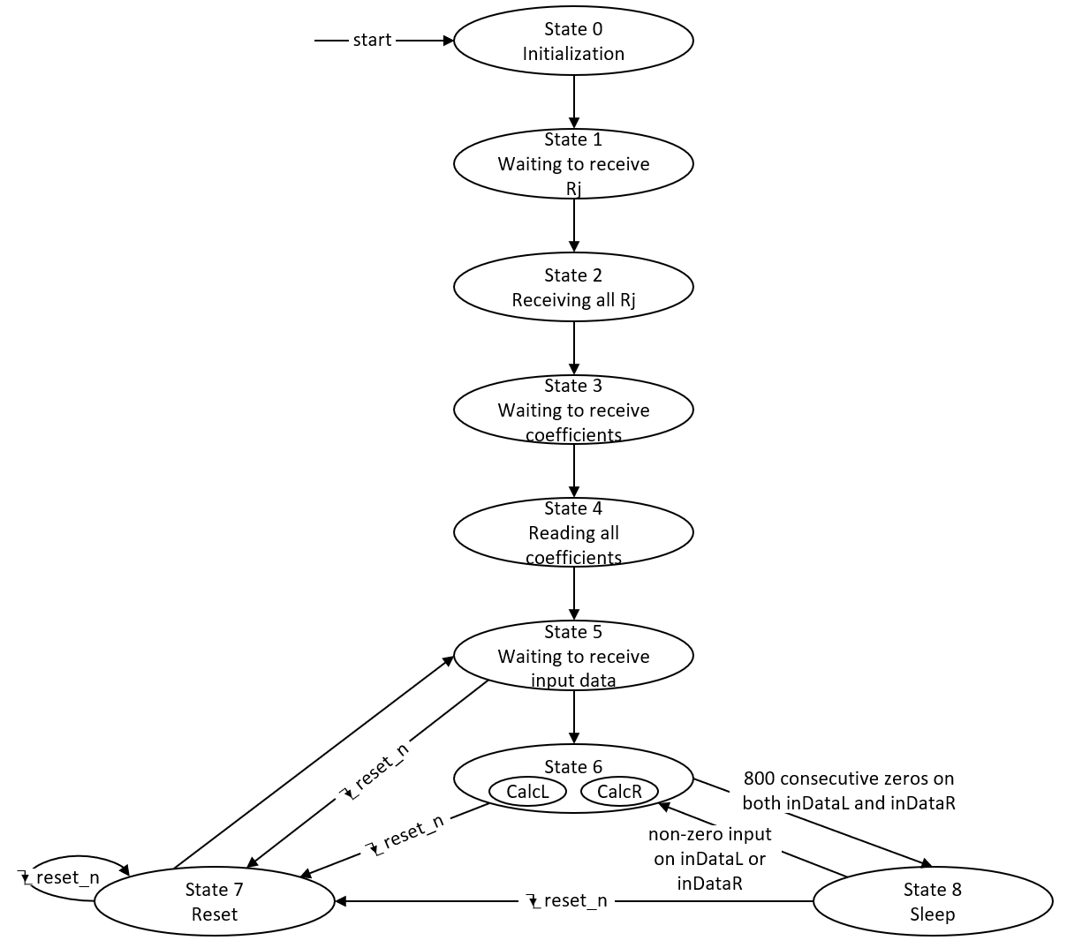
MSDAP FSM Module
This module:
Implements top level FSM
Handles states for reading data, calculation and output, sleep, and reset.
Instantiates S2P, memory, output, and calculation module.

Slide 6
MSDAP FSM Module Contd.
Signal Name | Input/Output | Size | Description
sClk | Input | 1 | System clock, provides the timing reference for internal signals and calculation modules, as well as the reference for the output samples.
dClk | Input | 1 | Data clock, provides the timing reference for input samples on inDataL and inDataR.
start | Input | 1 | Asynchronous signal, active high. Tells the chip to initialize and begin working.
reset_n | Input | 1 | Asynchronous, negative edge triggered reset signal for the main module. When reset_n is set low, the chip enters state 7 and resets.
frame | Input | 1 | Active high, frame is used to align the serial input data. Frame is set high for one dClk cycle when the first bit of some input data is received by the chip, and then it is set low.
inDataL | Input | 1 | Left data channel, responsible for transmitting all input data for the left channel, including Rjs, coefficients, and data samples. Data is transmitted serially, meaning one bit of data is sent at a time. The input data is read on the falling edge of dClk, and the MSB of data is transmitted first, while the LSB of data is transmitted last.
inDataR | Input | 1 | Right data channel, responsible for transmitting all input data for the right channel, including Rjs, coefficients, and data samples. Data is transmitted serially, meaning one bit of data is sent at a time. The input data is read on the falling edge of dClk, and the MSB of data is transmitted first, while the LSB of data is transmitted last.
inReady | Output | 1 | Set high on the rising edge of sClk when the chip is ready to receive input data. Otherwise, it is set low.
outReady | Output | 1 | Set high at the rising edge of frame when the chip is ready to transmit output data. Otherwise, it is set low.
outDataL | Output | 40 | Left output channel parallel data bus. Outputs all bits of the left channel output data on the rising edge of sClk. All bits are output on the 40-bit bus in one clock cycle.
outDataR | Output | 40 | Right output channel parallel data bus. Outputs all bits of the right channel output data on the rising edge of sClk. All bits are output on the 40-bit bus in one clock cycle.

Slide 7
S2P Module
This Module:
Converts serial input data to parallel output.
Directly interfaces with each memory module to store input data.
Signal Name | Input/Output | Size | Description
dClk | Input | 1 | Data clock
coeffIndex | Output | 9 | Coefficient Address to write to coefficient memory
coeffWriteL | Output | 1 | Write enable signal for left coefficient memory
coeffWriteR | Output | 1 | Write enable signal for right coefficient memory
dataIndexL | Output | 8 | Index of current left data
dataIndexR | Output | 8 | Index of current right data
dataWriteL | Output | 1 | Write enable signal for left data memory
dataWriteR | Output | 1 | Write enable signal for right data memory
dataWriteIndexL | Output | 1 | Address to write to left data memory
dataWriteIndexR | Output | 1 | Address to write to right data memory
done | Output | 1 | Signals to FSM that all Rjs have been received, all coefficients have been received, or one full data sample has been received
frame | Input | 1 | Used to indicate a new serial data input
inSerialDataL | Input | 16 | Left input serial data bus
inSerialDataR | Input | 16 | Right input serial data bus
inReady | Input | 1 | Indicates ready to receive input data
reset_n | Input | 1 | External, asynchronous reset signal
resetDataDone_n | Input | 1 | Reset after one data sample has been received
rjIndex | Output | 4 | Rj address to write to Rj memory
rjWriteL | Output | 1 | Write enable signal for left Rj memory
rjWriteR | Output | 1 | Write enable signal for right Rj memory
FSMState | Input | 4 | State of the MSDAP FSM module
Start | Input | 1 | External start signal, indicates when to begin receiving
toMemL | Output | 16 | Input data on left channel
toMemR | Output | 16 | Input data on right channel
wakeupSignal | Input | 1 | Signal used to awaken the S2P module after sleep

Slide 8
Data Memory Module
This Module:
Manages the memory space that stores the input data samples.
Contains a memory space of 256 16-bit numbers, with an address of size 8-bits.
Receives input data from the S2P module.
Outputs data read form the memory to the calculation module.
Signal Name | Input/Output | Size | Description
sClk | Input | 1 | System clock
dataReadAddr | Input | 8 | Memory address to read from
dataWriteAddr | Input | 8 | Memory address to write to
dataValueIn | Input | 16 | Input data value to write into memory
dataValueOut | Output | 16 | Output data value read from memory
memReset_n | Input | 1 | Memory reset signal, clears contents of memory
writeEnable | Input | 1 | Writes input data to input address when high

Slide 9
Rj Memory Module
This Module:
Manages the memory space that stores the input data Rj values.
Contains a memory space of 16 16-bit numbers, with an address of size 4-bits.
Receives input Rj values from the S2P module.
Outputs Rj values read form the memory to the calculation module.
Signal Name | Input/Output | Size | Description
rjReadAddr | Input | 5 | Memory address to read from
rjWriteAddr | Input | 4 | Memory address to write to
rjDataIn | Input | 16 | Input rj value to write into memory
rjDataOut | Output | 16 | Output rj value read from memory
writeEnable | Input | 1 | Writes input data to input address when high

Slide 10
Coefficient Memory Module
This Module:
Manages the memory space that stores the input coefficient values.
Contains a memory space of 512 16-bit numbers, with an address of size 9-bits.
Receives input coefficient values from the S2P module.
Outputs coefficient values read form the memory to the calculation module.
Signal Name | Input/Output | Size | Description
coeffReadAddr | Input | 10 | Memory address to read from
coeffWriteAddr | Input | 9 | Memory address to write to
coeffDataIn | Input | 16 | Input coefficient value to write into memory
coeffDataOut | Output | 16 | Output coefficient value read from memory
writeEnable | Input | 1 | Writes input data to input address when high

Slide 11
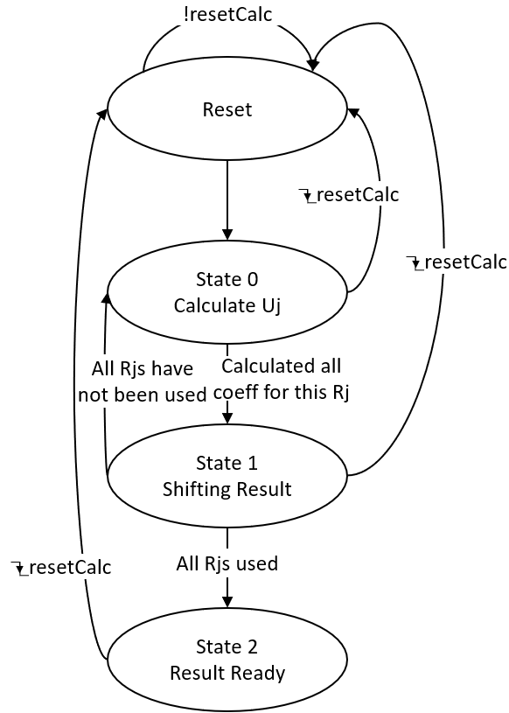
Calculation FSM Module
This Module:
Implements the FSM for the calculation module.
Instantiates the sign extend, ALU, and bit shifter modules.
Manages control signals for the calculation module.
Interfaces directly with the memory modules to request data sample, coefficient, and Rj values to be read from memory.
Determines when to shift, when the result has been calculated, and when the output result is ready.

Slide 12
Calculation FSM Module Contd.
Signal Name | Input/Output | Size | Description
sClk | Input | 1 | System clock
reset_n | Input | 1 | External, asynchronous reset signal
currentCoeffIndex | Output | 10 | Index of the coefficient that is being used for the current calculation
coeffExtracted | Input | 16 | Value of the current coefficient
dataIndex | Input | 8 | Index of the data sample being used by the current calculation
dataIndexToFetch | Output | 8 | Index of the data sample requested to fetch from memory
inData | Input | 16 | Data sent in from memory
currentRjIndex | Output | 5 | Index of the rj value being used by the current calculation
currentRjValue | Input | 16 | Value of rj being used by the current calculation
thisNCompleted | Output | 1 | Signal to indicate all iterations have been completed for the current n
overallResult | Output | 40 | Calculated output result

Slide 13
Sign Extend Module
Signal Name | Input/Output | Size | Description
inData | Input | 16 | Data sample input to the module after being read from memory
dataBitExtended | Output | 40 | Output data sample that has been sign extended and padded to 40 bits
This Module:
Accepts input data sample that has been read from the data memory.
Sign extends the data to 24 bits, and then pads 16 zeros on the right to make it 40 bits.
Outputs this result to the ALU.

Slide 14
ALU Module
This Module:
Obtains input operands from the sign extender and the bit shifter outputs.
Based on the input coefficient sign, adds or subtracts (using twos compliment) the two operands.
Outputs this result to the bit shifter.
Signal Name | Input/Output | Size | Description
sClk | Input | 1 | System clock
inCoeffSign | Input | 1 | Sign of the coefficient for the current calculation, determines if the input data sample will be added or subtracted from the running total
inOperandA | Input | 40 | Input to the ALU from the sign extender, contains the sign extended and padded input data sample
inOperandB | Input | 40 | Input to the ALU from the bit shifter, contains the bit shifted or non-bit shifted result of the previous calculation
calcResult | Output | 40 | Output result of the ALU calculation
ALUResultReady | Output | 1 | Indicates that the result has been calculated
ALUReset_n | Input | 1 | Resets the ALU

Slide 15
Bit Shifter Module
Signal Name | Input/Output | Size | Description
calcStage | Input | 3 | Stage of the calculation FSM
ALUResult | Input | 40 | Input result from the ALU
shifterDataResult | Output | 40 | Output result after being shifted/not shifted
This Module:
Accepts input from the output result of the ALU.
If the calculation FSM is in the shifting stage, it will shift the input result, padding with the sign bit.
If the calculation FSM is not in the shifting stage, it will simply pass the input result to the output.
Outputs the result back to the ALU, as well as to the Result Output module.

Slide 16
Result Output Module
This Module:
Accepts input results from the output of the calculation modules for both channels.
Outputs the result data on the sClk edge when the outReadyFromFSM signal is high, indicating that both calculation modules have completed.
Sends the outReady signal out of the device to the controller.
Signal Name | Input/Output | Size | Description
sClk | Input | 1 | System clock
outDataL | Output | 40 | Calculated result for the left channel sent to the output of the device
outDataR | Output | 40 | Calculated result for the right channel sent to the output of the device
outReadyFromFSM | Input | 1 | Signal from calculation FSM which indicates that both channels’ results have been calculated and are ready to be output
outReadyToTB | Output | 1 | Output signal of the device which indicates that the output is ready to the controller
resultL | Input | 40 | Input calculated result from the left channel calculation module
resultR | Input | 40 | Input calculated result from the right channel calculation module

